Slide 1
PRATICAL LEGAL AND INSURANCE CONSIDERATIONS FOR MITIGATING CYBER LIABILITIES
Northeast Ohio Information Security Forum
June 17, 2015
Isaac R. Figueras, Esq. • Meyers, Roman, Friedberg & Lewis, LPA
Rob Strachan • Strachan Novak Insurance Services

Slide 2
Introduction
Robert A. Strachan, CIC, AU, AINS, CPIA
Account Manager
Strachan Novak Insurance Services
330-963-3800, ext. 3014
rstrachan@sn-insure.com
Isaac R. Figueras, Esq.
Associate Attorney
Meyers, Roman, Friedberg & Lewis
216-831-0042, ext. 188
ifigueras@meyersroman.com

Slide 3
IBM & Ponemon Institute
Cybersecurity Breach Cost Calculator
(Condensed) Questions:
What is your primary industry?
What type(s) of personal, sensitive, or confidential information does your organization typically handle?
Do you have any sort of privacy and data protection program in place?
Do you have a dedicated Chief Information Security Officer (CISO) or is the management team of your organization involved in your data breach planning?
Does your organization use tools (e-mail encryption, cryptologic tools, firewall, antivirus, etc.) to secure personal, sensitive or confidential information?
6. Has your organization ever suffered a breach or loss of sensitive information?

Slide 4
Damage Analysis: Cybersecurity Breach Cost Calculator
How would your business fair?
Average Total Cost per Breach ~ $100,000.00
Average Chance of Breach ~ 10 – 11% in the next 12 months
What factors determine your cost?
It’s More than just Security Protocols
Industry, Information Type, Geographic Footprint, Organizational Structure, and More Factors Contribute to Cost

Slide 5
What Are Your Potential Sources of Liability? Federal vs. State Regulatory Regimes
State Laws regarding Breach Notifications
Federal Regulators – Industry Specific:
Breach Notifications
Minimum Security Requirements
Records Retention and Destruction Policies
Upcoming:
“Cyber Threat Intelligence Integration Center”
A “Cyber Intelligence” Hub for Federal Agencies
Private Actions:
Class Actions from Individuals
Breach of Contract / Business Disputes
Credit Card Issuers

Slide 6
What Types of Sensitive, Confidential or Personal Information Does your Business Possess?
Consumer Information
vs.
Confidential Information

Slide 7
What Legal Factors Are Contributing to Your Company's Overall Cost of Breach?
Insecure Network
Employee Negligence, Misconduct
Archaic or Undependable Systems
Unsecured or Easily Stolen Devices
Lack of Physical Security

Slide 8
What Factors Are Lowering Your Company's Overall Cost of Breach?
Developing a Formal, Enterprise Wide Data Protection Program
Appointing a Chief Security Officer ("CISO, CTO, CIO")
Involving Management in Breach Planning
Using Tools to Protect Data
Vendor Due Diligence

Slide 9
WHAT TO CONSIDER
Upstream (Customers)
Downstream (Vendors, Contractors, Subcontractors)
Business
Owner
Employees

Slide 10
Cyber Security and Workplace Policies

Slide 11
The Road to Security
Cybersecurity and Legal Audit:
Contract Review (Both Customer and Supplier)
Review Industry Standards
Infrastructure Review
Employment Handbook Review
Employee Training
System Security (Cyber and Physical)
The FTC's Mindset:
The security process is constant
A company’s procedure must be reasonable in relation to its situation
A breach does not mean a company failed to have measures
A lack of a breach does not mean the company’s procedures are reasonable
Identify, Protect, Detect, Respond, Recover

Slide 12
Cost per Record = $200 4,000 Customers = $800,000
How many companies have an $800,000 rainy day fund?
Robert A. Strachan CIC, AINS, AU, CPIA

Slide 13
What is Cyber Insurance Today?
Cyber insurance provides first-party and third-party liability coverage to companies when personal/confidential information is compromised and other cyber related events
Forensic Expenses: You have determined that data has been compromised and need to investigate what happened, how it happened, and what information was accessed.
Legal Expenses: You will need legal representation in order to determine the scope of the federal and state notification requirement breaches. You will also need legal counsel to defend you in the event a suit is filed against you.
Notification Expenses: These expenses can include postage, paper, printing, call centers, etc.
Regulatory Fines and Penalties: What more can I say? The government will want, and get, their pound of flesh.
Credit Monitoring and ID Theft Repair: While not legally required, it is generally agreed that offering these services to the affected parties will reduce potential legal liability and is considered the right thing to do.
Public Relations Expenses: The manner in which the breach is reported to the media is crucial to restoring your reputation and maintaining your clients, vendors, business associates, partners, and patients.
Liability and Defense Costs: It’s not uncommon for class action lawsuits to be filed against you following a breach. You will need legal representation which can be of your own choice or appointed by the carrier.
Business Interruption Expense:
When your business is sidelined due to picking up the pieces of a breach, where do you find the funds to pay key
personnel and fixed expenses?

Slide 14
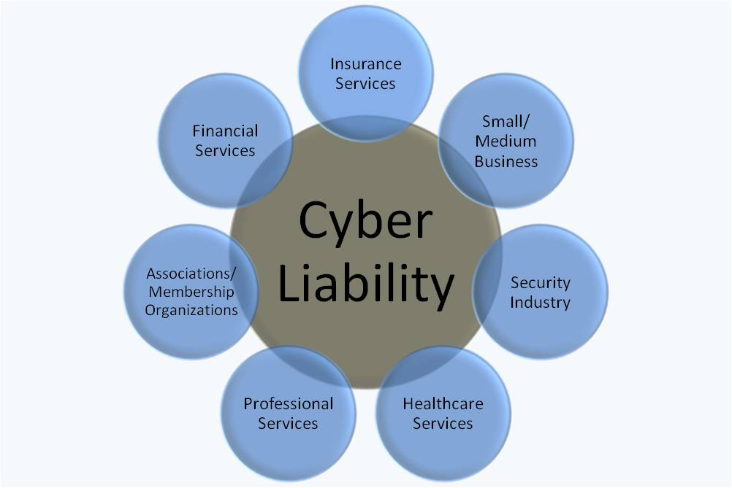
Who needs Cyber Insurance?
It can happen to anyone…
Notes:
As Isaac and Paul noted earlier, everyone has a cyber exposure – You have the opportunity to self insure or buy insurance for the risk.

Slide 15
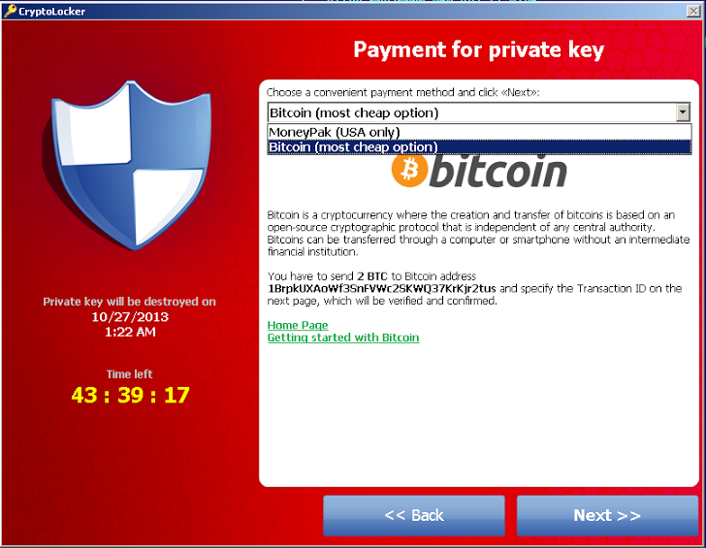
You arrive at your office and your computer has this:
Notes:
What do you do? You call your IT company/guy….. And unfortunately you are stuck with the realization that you have to start cleaning up the mess. You are now distracted from running your company or making money and the cost of a breach clock has just started…..

Slide 16
So now we have a loss… Where do we get coverage come from?
Commercial Property Policy
Business Interruption
Crime Policy
General Liability Policy
Professional Liability Policy
Electronic Data Extension only addresses loss or damage to data which has been destroyed or corrupted by a covered cause of loss.
Business Income coverage from covered cause of loss only
No coverage due to the Definition of “Other Property”, the Exclusion of “Indirect Loss” and the Exclusion for theft of confidential information.
Addresses only bodily injury to persons or tangible property, as well as the Insured’s publication of material that violates a person’s right to privacy.
May be limited by the description of “Professional Services” or by Exclusions for “Invasion of Privacy”
In short…. None of these…
Notes:
Most people believe their current insurance policy will provide protection. Unfortunately, under most insurance policies there are specific endorsements that limit or exclude losses from data breaches. This leaves a huge gap in coverage and therefore a potential for bankrupting the company.

Slide 17
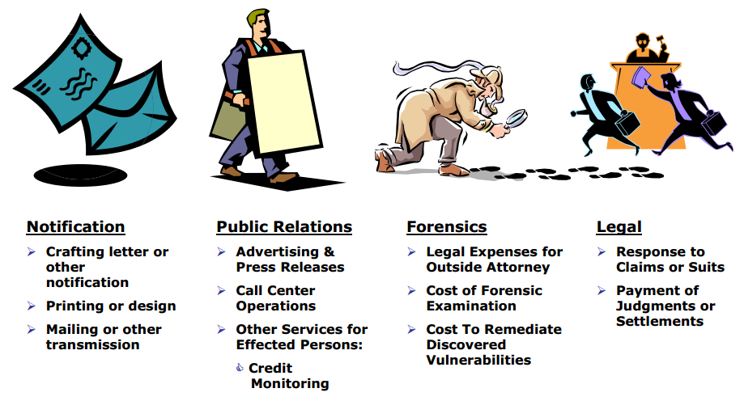
Breach related expenses…

Slide 18
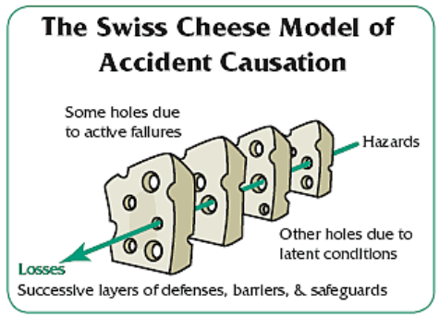
Not every policy is the same…
DOES THE POLICY ADDRESS:
Access to information other than over the Internet?
Access to information by an employee?
Access to information residing on an “outsourced” system – anywhere?
Access to information in “non-electronic” form?
Negligent release of information?
Lost Laptops and other mobile devices?

Slide 19
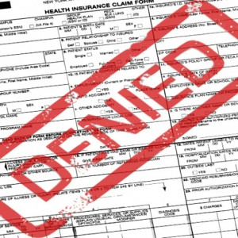
Watch the Exclusions…
Some policies exclude coverage for claims related to the Insured’s failure to maintain or upgrade their security
Some policies exclude coverage for claims alleging fraudulent or malicious acts by employees
Some policies exclude certain operations of the Insured, or may not cover various types of computer or peripheral device

Slide 20
Recommendations for Buying Cyber Insurance
Identify Your Unique Risks
Understand Your Existing Coverage
Buy What You Need
Secure Appropriate Limits and Sub-limits
Beware of Exclusions
Get Retroactive Coverage
Consider Coverage for Acts and Omissions by Third Parties
Evaluate Coverage for Data Restoration Costs
Take Advantage of Risk Management Services
Dovetail Cyber Insurance with Indemnity Agreements
Understand The “Triggers.”
Consider Coverage for Regulatory Actions
Notes:
Identify Your Unique Risks – What do you do/what are your potential claims???
Understand Your Existing Coverage – Do you currently have sub limits or coverage elsewhere?
Buy What You Need – You can purchase many types of cyber insurance…. Make sure you are buying the correct type
Secure Appropriate Limits and Sub-limits - How much is enough?
Beware of Exclusions -
Get Retroactive Coverage – You can buy policies that cover prior acts before the policy was written – more expensive but might be nice to have.
Consider Coverage for Acts and Omissions by Third Parties – Vendors/off site companies
Evaluate Coverage for Data Restoration Costs – Audit computer/network systems. How much does it cost to replace?
Take Advantage of Risk Management Services – Always.
Dovetail Cyber Insurance with Indemnity Agreements - Talk with attorneys, try to shore up contracts with vendors/third party people
Understand The “Triggers.” -
Consider Coverage for Regulatory Actions -

Slide 21
How is a Cyber Policy Underwritten?
No two businesses are alike therefore there isn’t a cookie cutter policy. Basic information required for indication:
Insurance Company Application
Controls in place
Types of data held
Third party contractual agreements
Formal written incidence response plan
Intrusion detection system
(See application)

Slide 22
How much does it cost?
It depends on limits/exclusions/etc…
Premiums can range from $700 to $200,000 with a limit of $1 million.
In today’s world $1 million rarely comes close to covering the total expenses of a hack. Cyber insurance can ease the pain, but it won’t eliminate it. Most policies are nowhere near inclusive of all cost associated with breaches but they can certainly offset the cost of the response and first-party monetary loss for breach victims.

Slide 23
PROTECTING YOUR BUSINESS
AGAINST
CYBER THREATS
QUESTIONS?
Isaac R. Figueras, Esq. • Meyers, Roman, Friedberg & Lewis, LPA
ifigueras@meyersroman.com
Rob Strachan • Strachan Novak Insurance Services
rstrachan@sn-insure.com

